Slide 1


Food Nutrition Analyzer and Meal Planner
This Photo by Unknown author is licensed under CC BY-NC-ND.
Saketha Kusu

Slide 2
Introduction:
The Food Nutrition Analyzer and Meal Planner is a program designed to simplify the process of tracking the nutritional content of meals and planning balanced diets.
It aims to provide users with a user-friendly interface to select food items and obtain their nutritional information.
By empowering users with detailed nutritional data on their food choices, the project promotes healthier eating habits and contributes to overall well-being.

Slide 3
Objectives
Simplify Tracking Nutritional Content: The project aims to simplify the process of tracking the nutritional content of meals by providing users with an easy-to-use interface and automated calculations.
Assist in Planning Balanced Diets: Another objective is to assist users in planning balanced diets by providing them with insights into the nutritional composition of their meals, helping them make informed dietary choices.

Slide 4
Python Packages/Modules:
Pandas: To handle the dataset containing nutritional information.
Tkinter: To create the program's graphical user interface (GUI).
Message box: To display warning and information messages to the user.

Slide 5
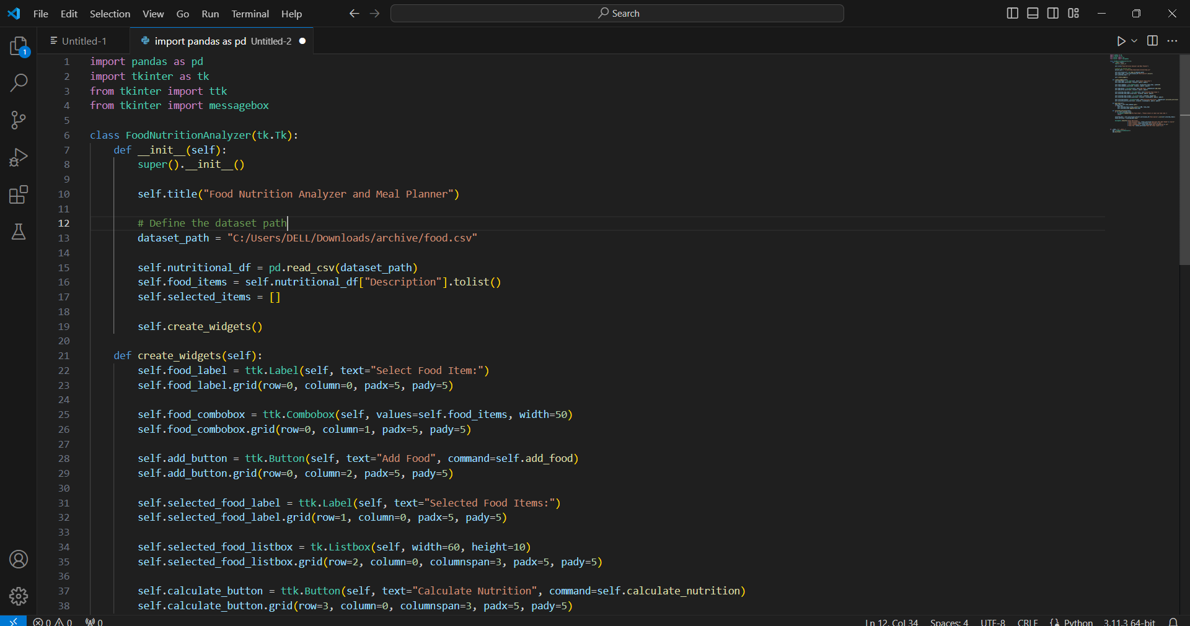

Slide 6
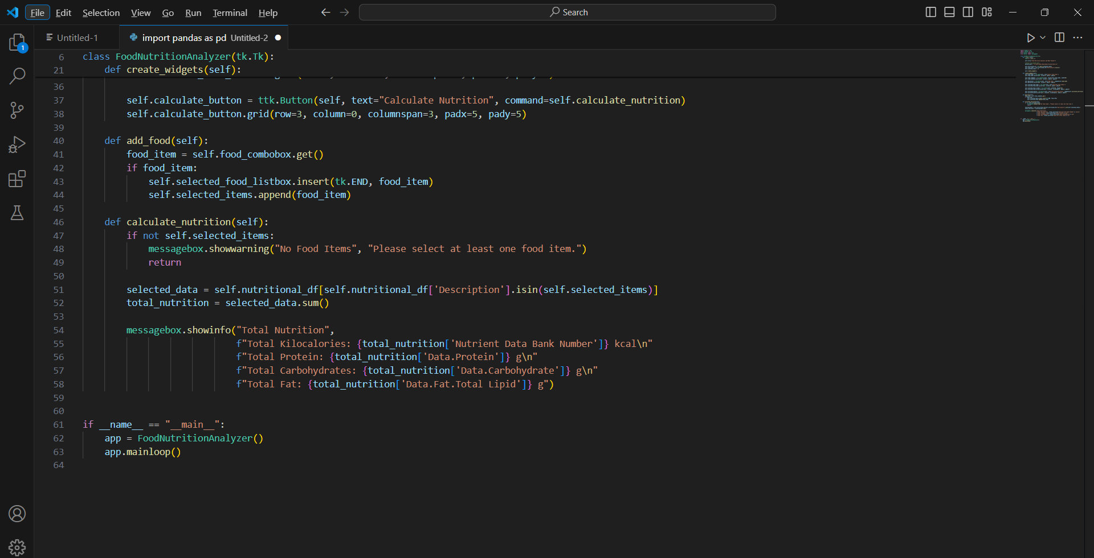

Slide 7
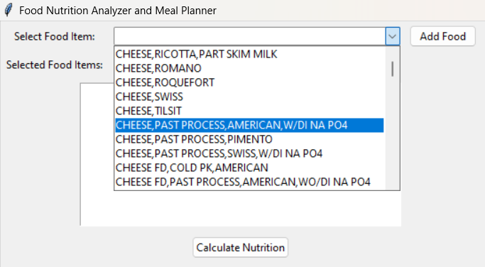
Input
Users interact with the program by selecting food items from a dropdown menu provided by the graphical user interface (GUI).
The user's selection is then added to a meal list within the program.

Slide 8
Output
Upon user request, the program calculates the total nutritional values (calories, protein, carbohydrates, fat) for the selected meal.
1
The calculated nutritional values are displayed to the user in a message box or another designated area within the GUI.
2
Additionally, the program may display warning messages using the message box module in case of errors or invalid inputs, ensuring a smooth user experience.
3

Slide 9
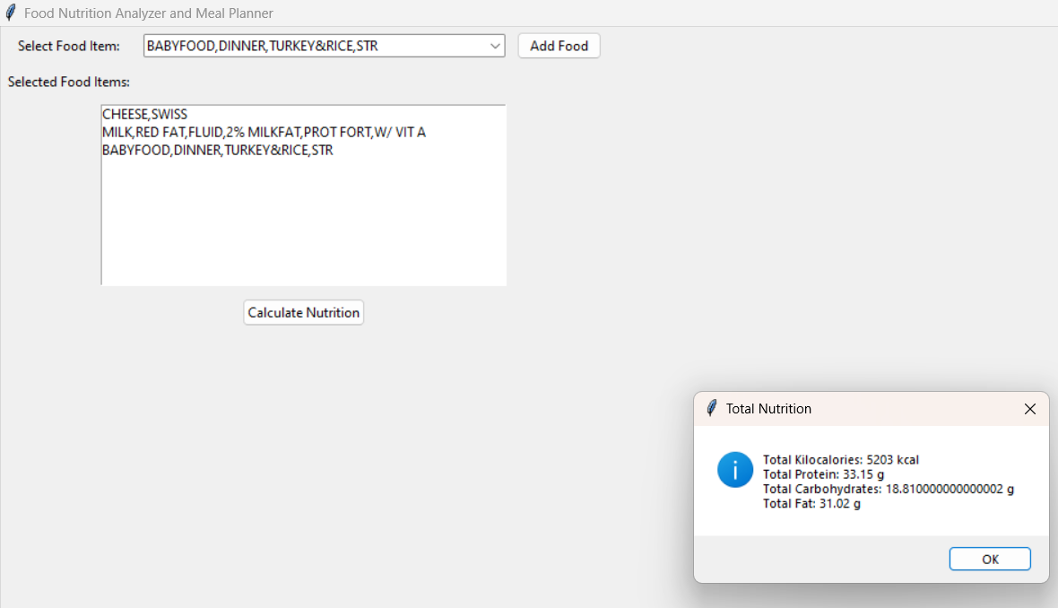

Slide 10

Thank you

